Slide 1

SCHOOL OF COMPUTING
DEPARTMENT OF NETWORKING AND COMMUNICATION
18CSC305J - ARTIFICIAL INTELLIGENCE
EVEN SEMESTER 2022
SEMESTER END PROJECT VIVA VOCE EXAMINATIONS
SONAR - Rock VS Mine Prediction
SUPERVISED BY:
MS.M.THENMOZHI,
Associate Professor
PRESENTED BY:
Sithara Swaminathan – RA1911028010083
Madhuja Sinha - RA1911028010088
Soham Das - RA1911028010106

Slide 2
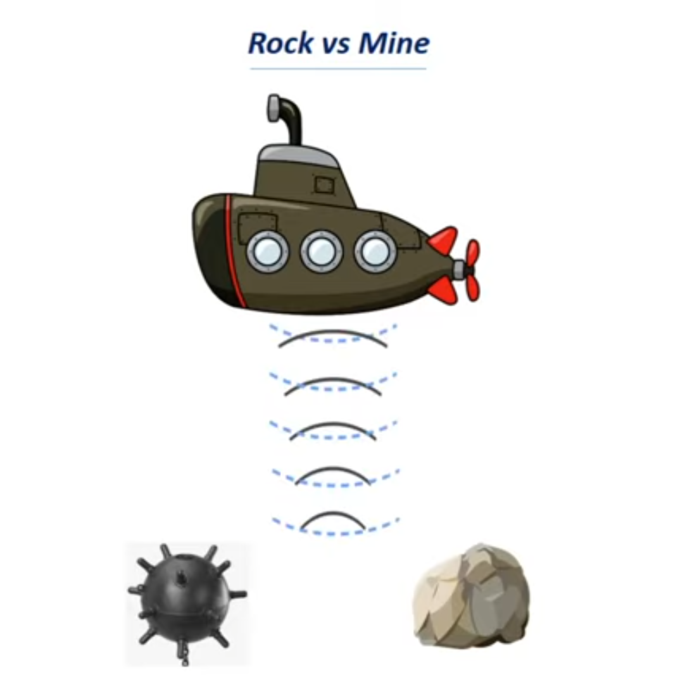
ABSTRACT
During a war between two countries the naval forces use submarines to fight wars. Submarines are at a great risk of getting blown by ocean mines planted by the enemies. The submarines are fully equipped with SONARs. These SONARs detect objects near the submarines. But not all the objects being detected are mines. Now how the submarine differentiates between the mine and a rock is a perfect use case of machine learning.

Slide 3
LITERATURE SURVEY
The discovery of rocks and minerals would have been very difficult past the development of the SONAR technique, which relays on certain parameters to be able to detect the obstacle or the surface is a rock or a mine. Machine learning has drawn the attention of maximum part of the technology related and based industries, by showing advancements in the predictive analytics. The main aim is to emanate a capable prediction representative, united by the machine learning algorithmic characteristics, which can figure out if the target of the sound wave is either a rock or a mine or any other organism or any kind of other body.

Slide 4
LITERATURE SURVEY(cont.)
This attempt is a clear-cut case study which comes up with a machine learning plan for the grading of rocks and minerals, executed on a huge, highly spatial and complex SONAR dataset. The attempts are done on highly spatial SONAR dataset and achieved an accuracy of 83.17% and AUC came out to be 0.92. With random forest algorithm, the results are further optimized by feature selection to get the accuracy of 90%. Assuring results are found, when the fulfilment of the designed groundwork is set side by side with the standard classifiers like SVM, random forest, etc. using different evaluation metrics like accuracy, sensitivity, etc. Machine learning is performing a major role in improving the quality of detection of underwater natural resources, and will tend be better in the near future.

Slide 5
WORKFLOW
Collection of sonar data – The SONAR data of the can be collected in form of a CSV file. CSV file can be viewed through MS excel, Notepad, or Power BI.
Data pre-processing and analysis – Removal of unwanted data and outliers are an important part because it can drastically effect the accuracy score and other statistical measures.
Feeding the sonar data to machine learning model – This is done to train the model before testing can be done. The higher amount of data we feed higher is the level of training and higher will be the accuracy score.

Slide 6
WORKFLOW(cont.)
Splitting into training and test data- Segregation of the given dataset is very important. Training data is the data from which the machine will be learning and training the model on the other hand test data is the data which is completely unknown to our machine.
Logistic Regression – We will be using logistic regression model to predict between rock and mine which we are going to discuss in further slides
Supervised Learning algorithm - A supervised learning algorithm takes a known set of input data (the learning set) and known responses to the data (the output), and forms a model to generate reasonable predictions for the response to the new input data.

Slide 7
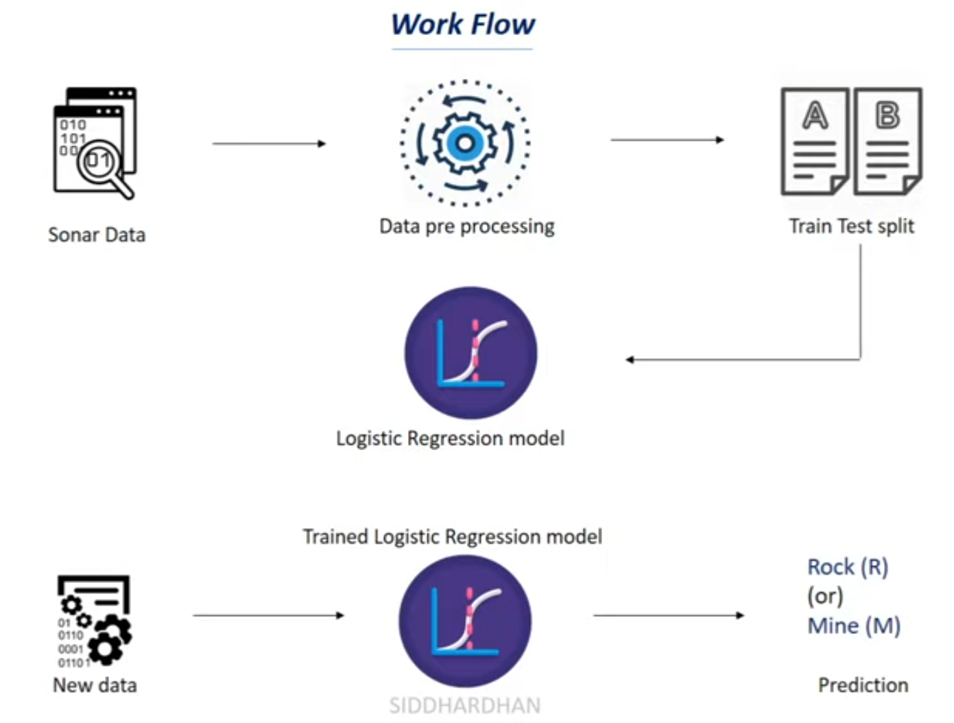

Slide 8
REQUIREMENT ANALYSIS
MS EXCEL – A CSV is a comma-separated values file, which allows data to be saved in a tabular format. CSVs look like a garden-variety spreadsheet but with a . csv extension. CSV files can be used with most any spreadsheet program, such as Microsoft Excel
NOTEPAD – To extract data during the testing of our model
JUPYTER NOTEBOOK – Jupyter Notebook is an open-source web application that allows a user, scientific researcher, scholar or analyst to create and share the document called the Notebook, containing live codes, documentation, graphs, plots, and visualizations.

Slide 9
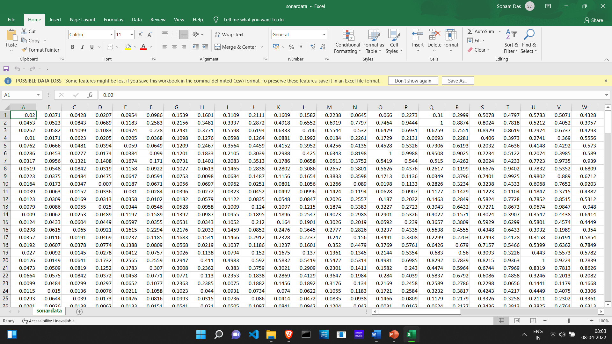
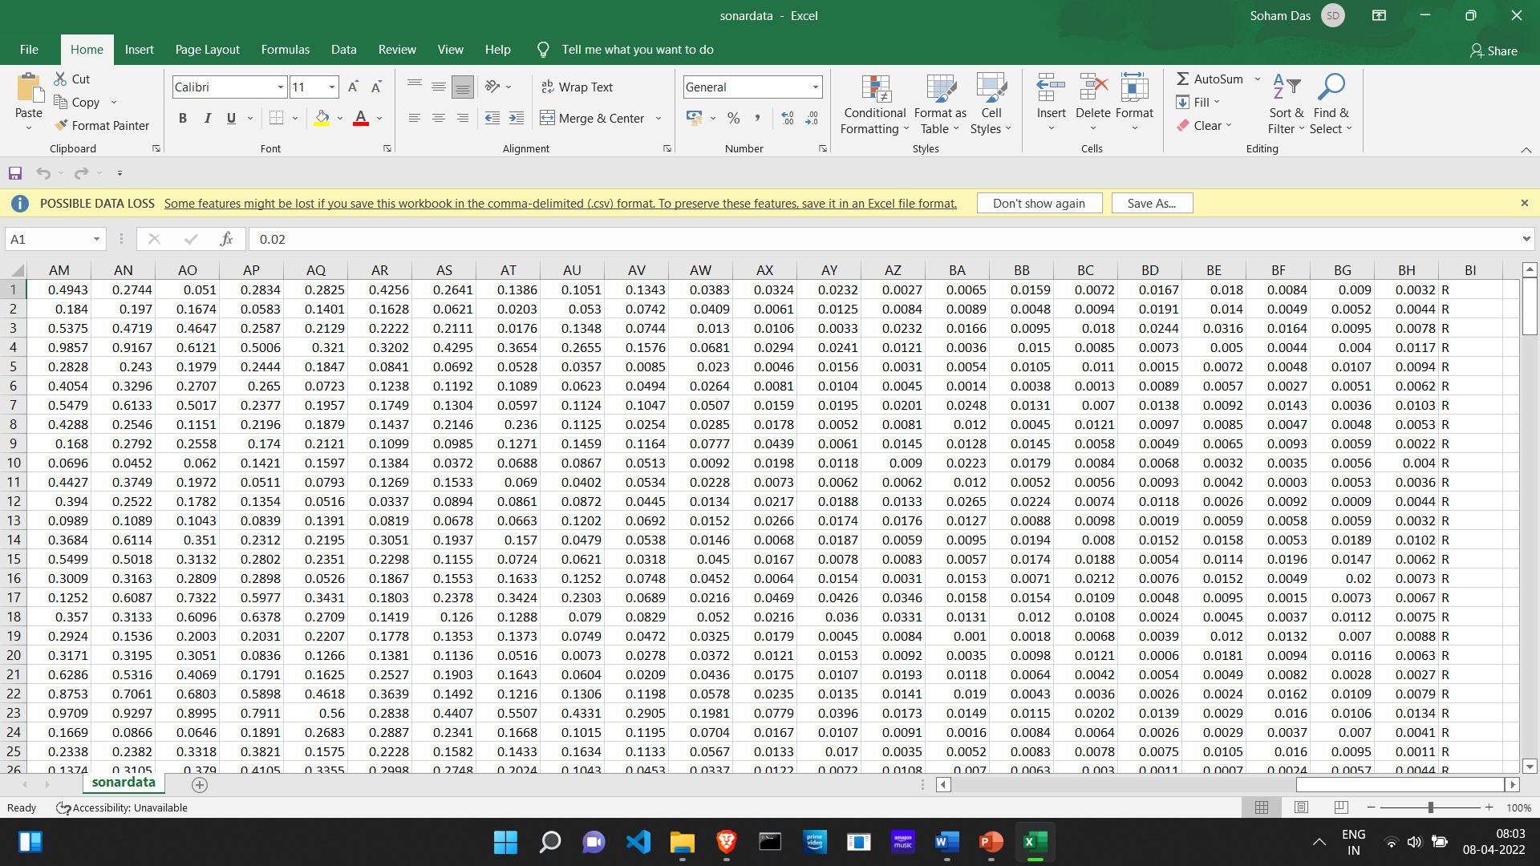
DATASET(cont.)

Slide 10
DATASET
Data is collected and is in CSV format.
There are all total of 208 data points.
If we see the last column of every data point its mentioned R or M.
R denotes Rock and M denotes Mine.
Since we already know the results from the beginning we can say it’s a Supervised Learing Algorithm.
We feed this data set for our machines for model training.

Slide 11
REQUIREMENT ANALYSIS
MS EXCEL – A CSV is a comma-separated values file, which allows data to be saved in a tabular format. CSVs look like a garden-variety spreadsheet but with a . csv extension. CSV files can be used with most any spreadsheet program, such as Microsoft Excel
NOTEPAD – To extract data during the testing of our model
JUPYTER NOTEBOOK – Jupyter Notebook is an open-source web application that allows a user, scientific researcher, scholar or analyst to create and share the document called the Notebook, containing live codes, documentation, graphs, plots, and visualizations.

Slide 12
DEPENDENCIES
NumPy – NumPy can be used to perform a wide variety of mathematical operations on arrays.
Pandas - Pandas is mainly used for data analysis and associated manipulation of tabular data in dataframes.
Sklearn.modelselection – train_test_split - train_test_split is a function in Sklearn model selection for splitting data arrays into two subsets: for training data and for testing data.
Sklearn.linear_model import logisticRegression - linear_model is a class of the sklearn module if contain different functions for performing machine learning with linear models.
Sklearn.Metrics import accuracy_score - Accuracy classification score. In multilabel classification, this function computes subset accuracy

Slide 13
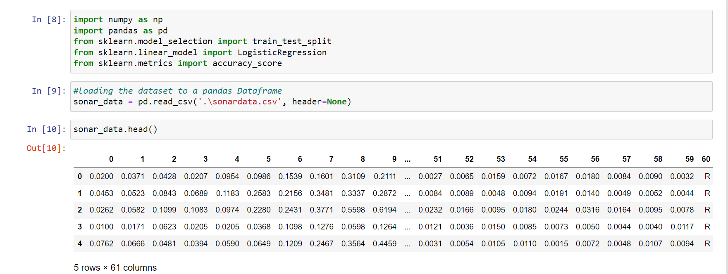
DATA COLLECTION AND DATA PROCESSING
Loading the dataset and making it an pandas dataframe.
Read.csv() to read the csv file containing the sonar data.
Since there is no header file we need to mention that as ‘none’.

Slide 14
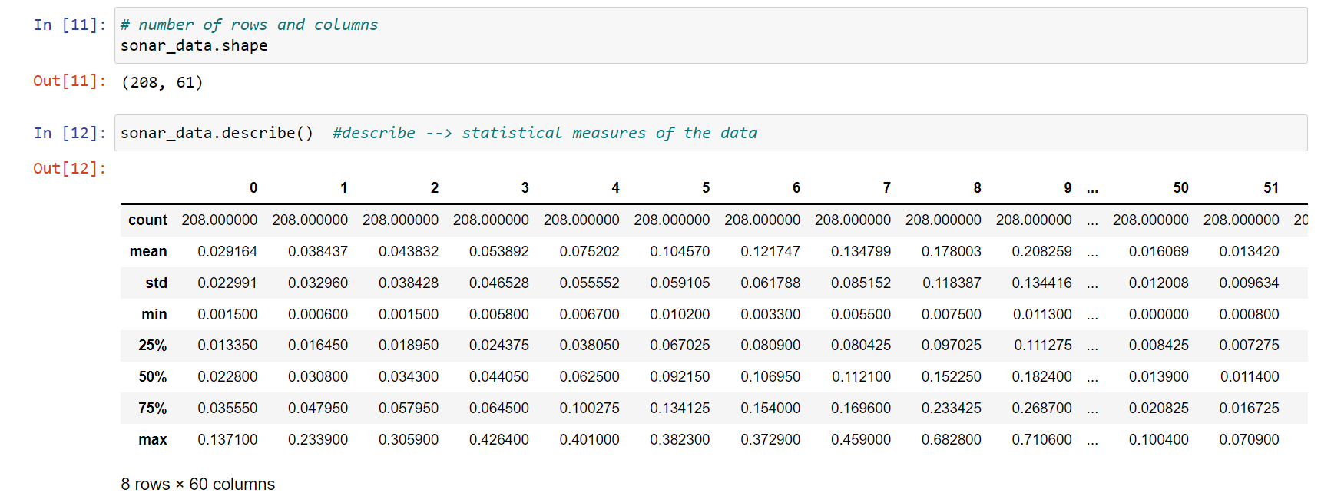
DATA COLLECTION AND DATA PROCESSING
.shape() - We check the number of rows and columns present in the data set.
We get the result as 208, 16
.describe() – mean SD and other statistical measures for out data.
Determine how many data of rocks are there and how many data for mines.

Slide 15
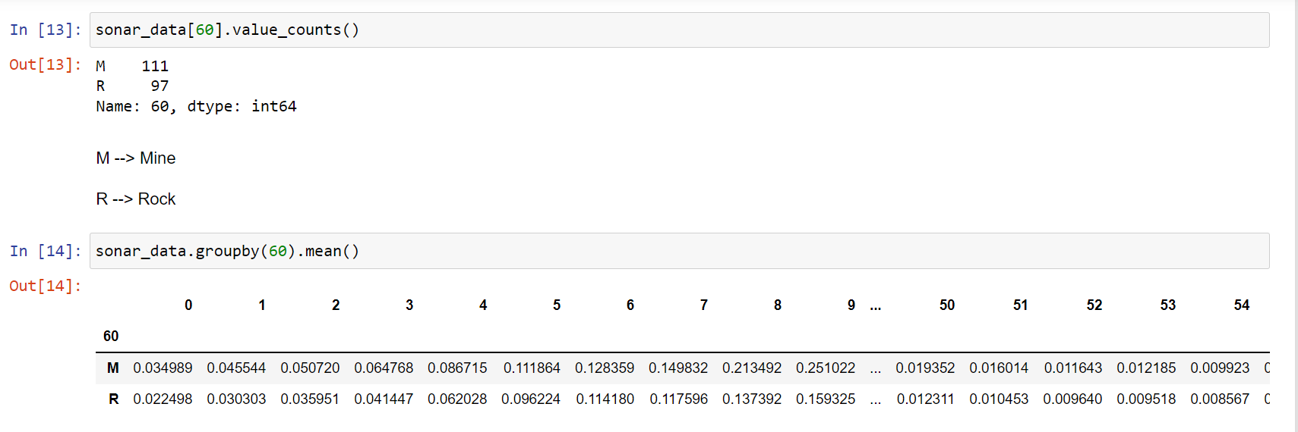
DATA COLLECTION AND DATA PROCESSING
60 because the rock and mine are specified in the 60th column
111 – m 97 – r
More the data more accurate will be the model.
.groupby() - We need to group the data on the basis of rock and mine.
Separate data and labels – we are dropping the 60th column and storing 60th column in another variable.

Slide 16
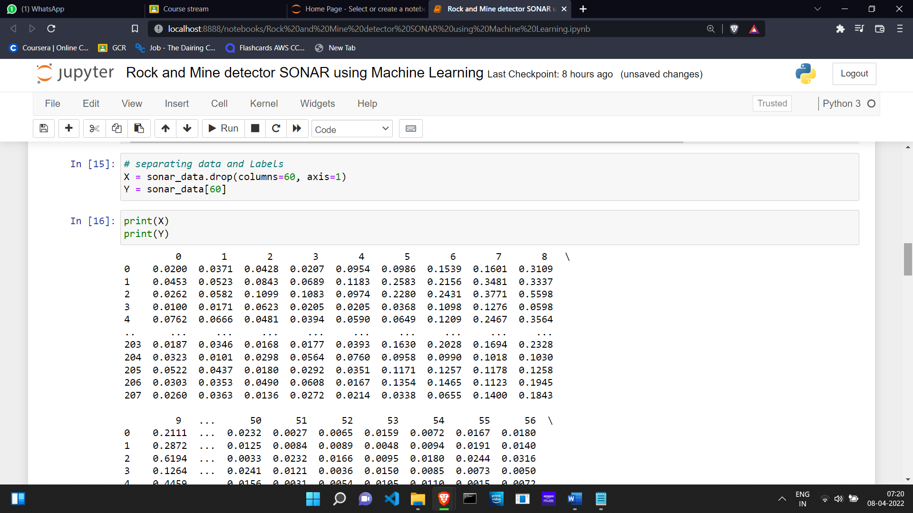
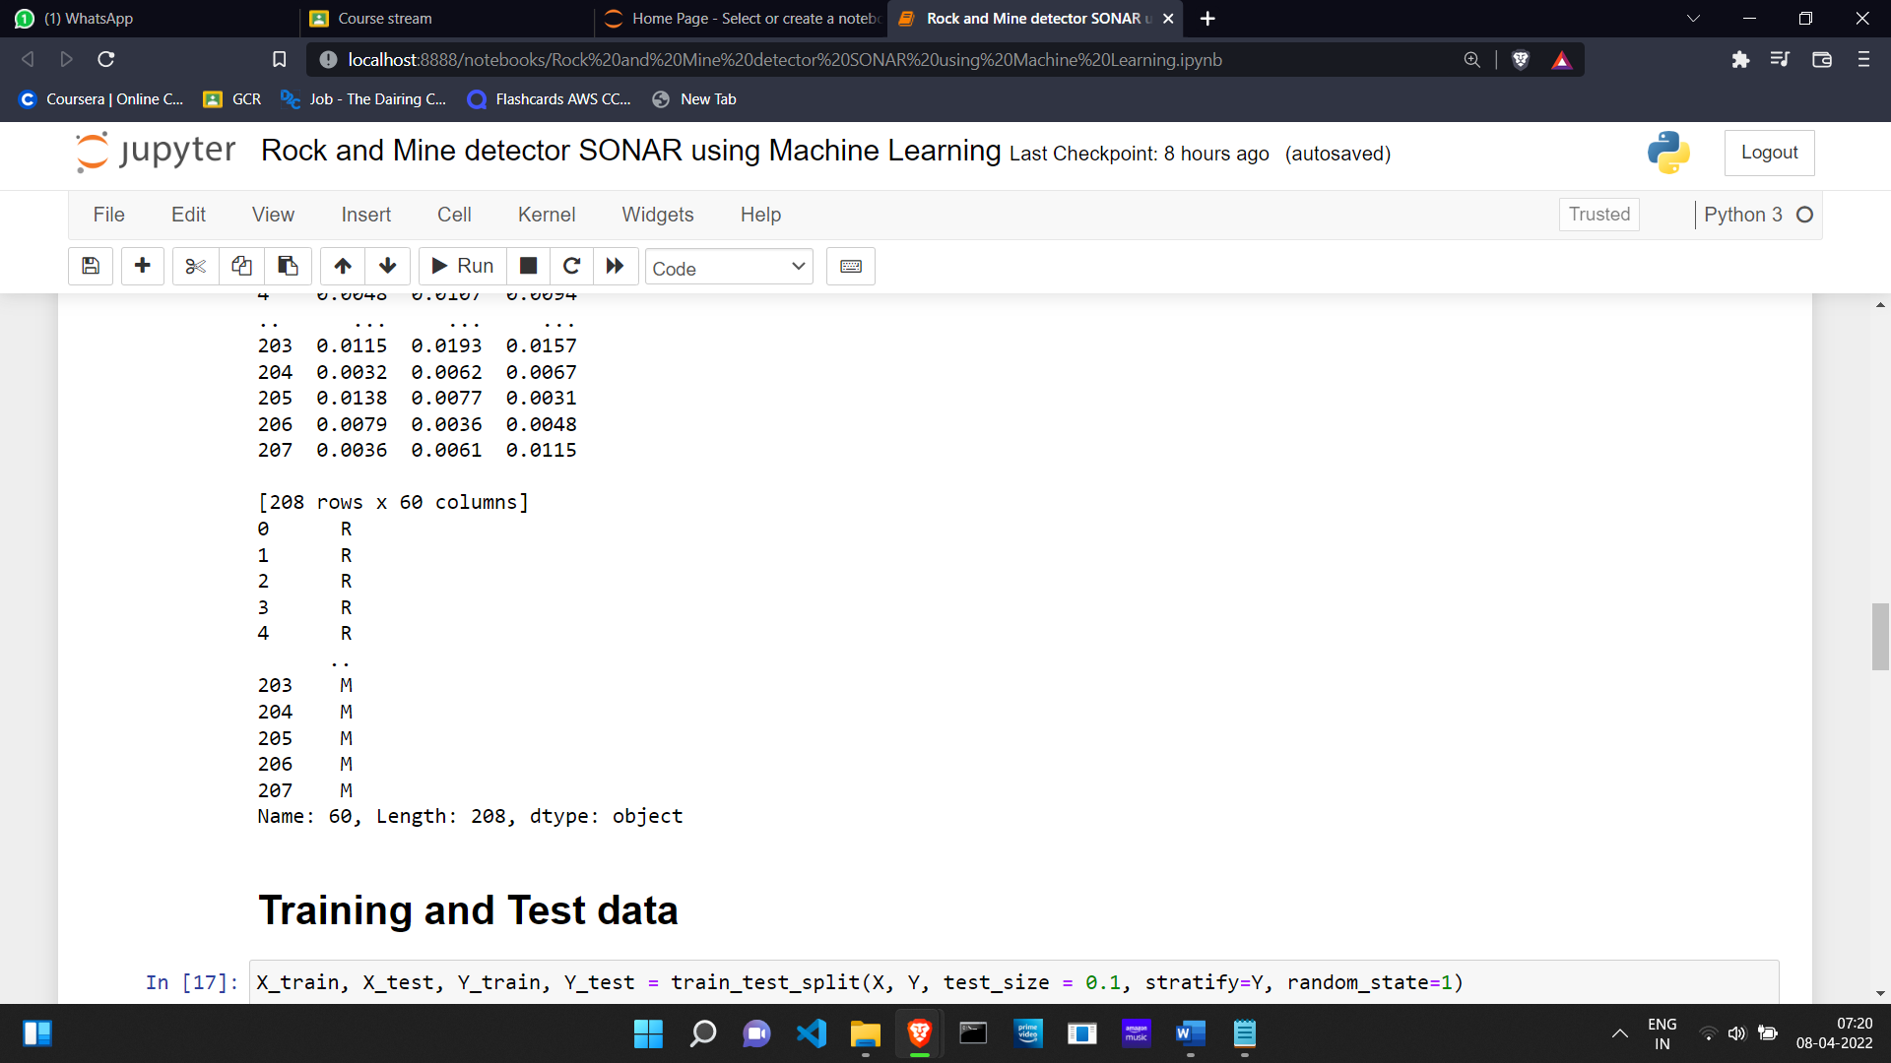
DATA COLLECTION AND DATA PROCESSING
Separate data and labels – we are dropping the 60th column and storing 60th column in another variable.

Slide 17
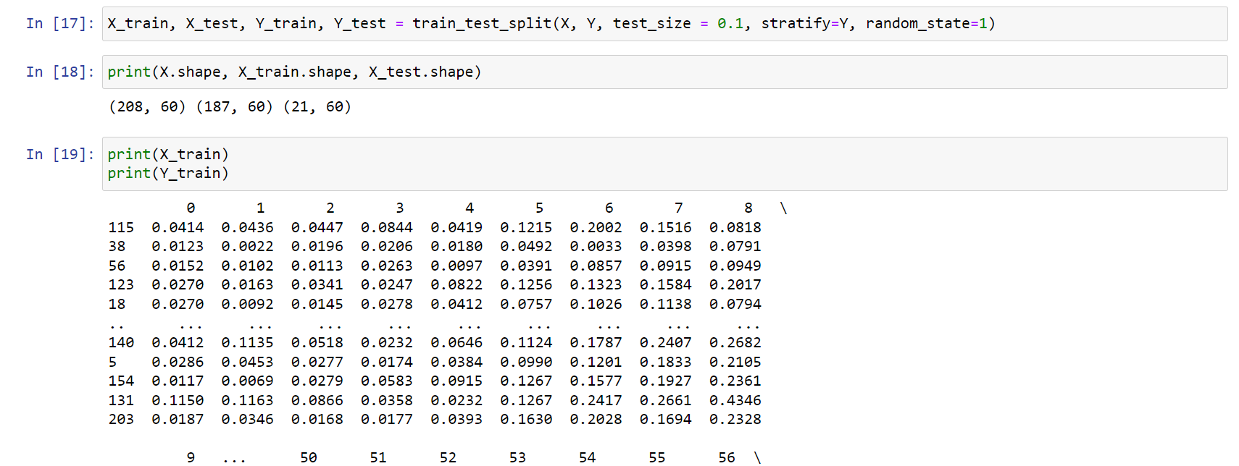
TRAINING AND TEST DATA
We need to split the data into training and test data.
(X, Y, test_size, Stratify, random_state)
We need 10% of the data to be test data.
Stratify = we need to split the data equally based on number of rock and mine
Random_state = to split our data in a particular way
187 training data and 21 test data

Slide 18
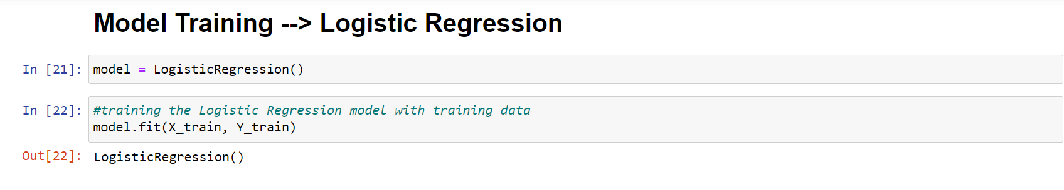
MODEL TRAINING
Model training:
Logistic regression model
Train it with training data.
.fit(X_train, Y_train) to train our model

Slide 19
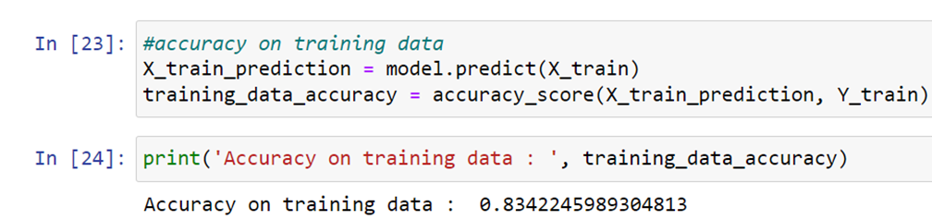
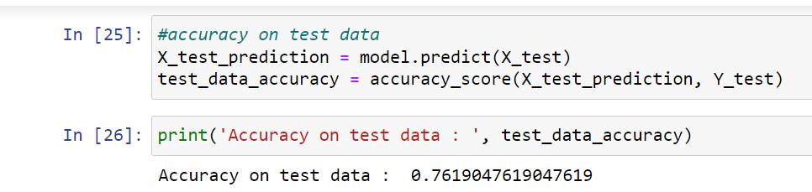
MODEL EVALUATION
The training data accuracy and the test data accuracy are both calculated and both are more than 70% so the accuracy is good.
If we would have used more data somewhat like 1000-2000 the accuracy would be little higher.
Model.predict() – prediction of training data accuracy score.
83.42 % accuracy for training.
Now we will check accuracy on test data. The model has not seen this data yet.
76.19 % accuracy for testing.
So out of 100 time 76 times the model can predict the correct object.

Slide 20
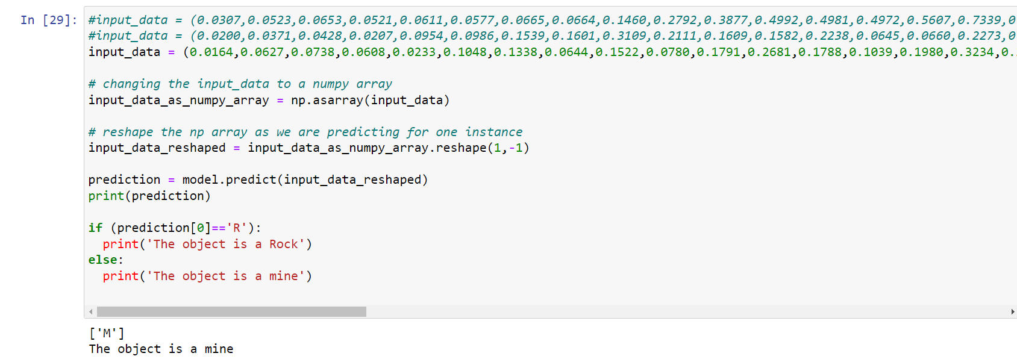
MAKING UP THE PREDICTIVE SYSTEM
We take the input data and convert in np array to reduce the time complexity.
We feed a sample data to check whether the model is working fine or not.
We need to reshape the array to avoid confusion from the model side and we are predicting for one instance.
Calling the model functions in the model.predict().
Returns R or M.

Slide 21
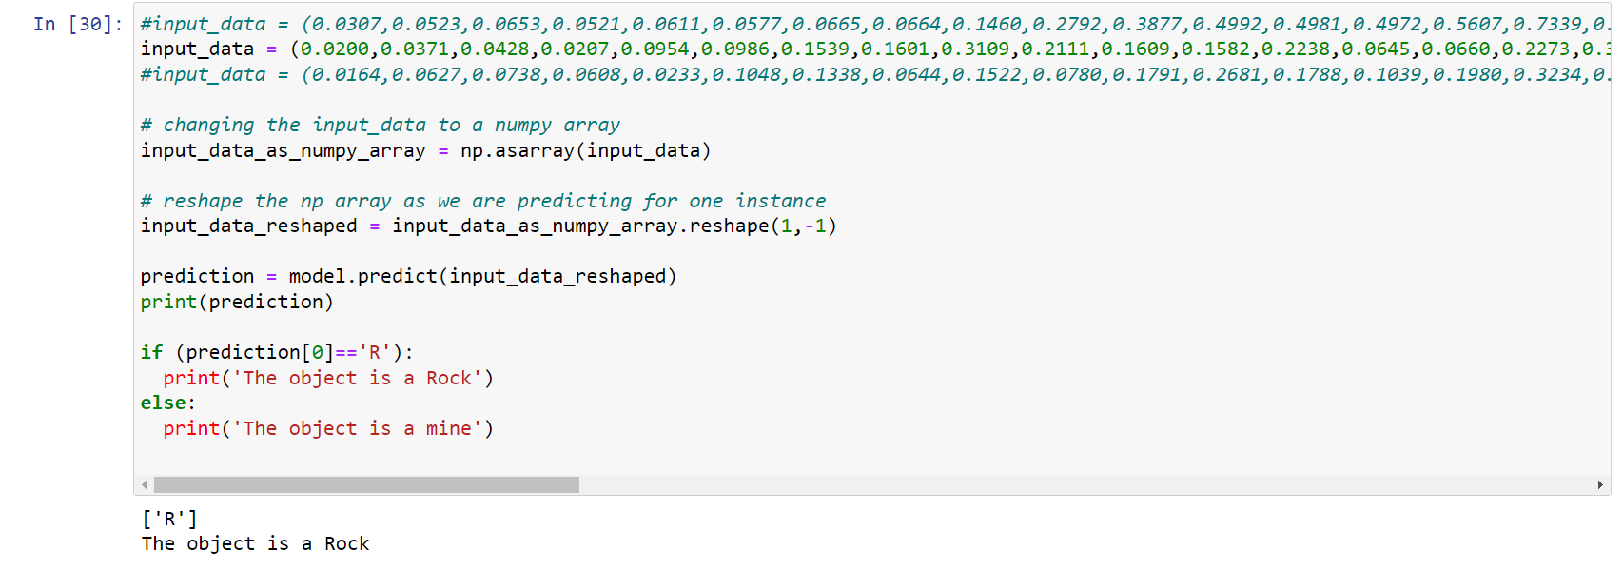
MAKING UP THE PREDICTIVE SYSTEM

Slide 22
FUTURE PROSPECTS
In the ocean bed there are many more unwanted materials other than rock which can effect the prediction procedure of our model. Radioactive wastes, plastic wastes and many other kinds of mines are also present there. For such a sensitive calculation the accuracy should be very high like 85-90%. This machine learning model which we made needs a lot more of improvement and improvisation to properly determine the type of material that is encountered.
For future work more, complex data will be handled using big data Hadoop framework. With random forest algorithm, the results are further optimized by feature selection to get the accuracy of 91.15%
The project we did majorly focuses on the backend working of the sonar the frontend development need the knowledge of flask or Django framework. After acquiring that knowledge we would be able to develop the frontend and think of deployment.

Slide 23
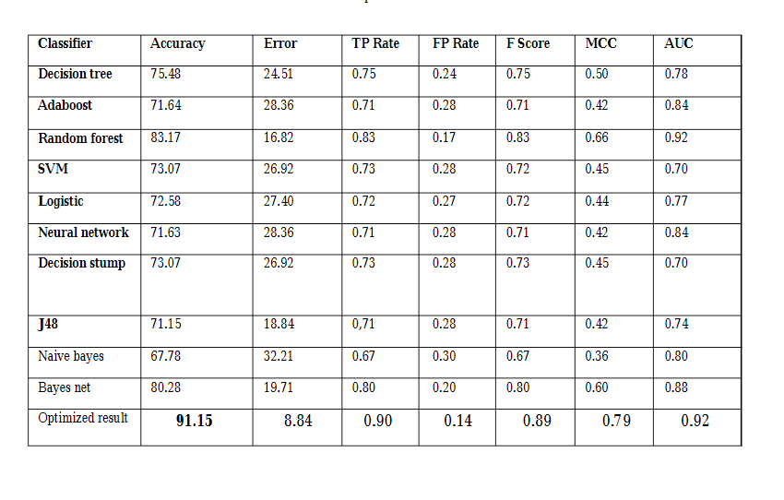
FUTURE PROSPECTS

Slide 24
CONCLUSION
An adequate prediction miniature, united with the machine learning classifying features, is proposed which can conclude if the target of the sound wave is either a rock or a mine.

